Slide 1


Strengthening Resident and Family Councils
Problem Solving in Long-Term Care:
Tips for effective complaint and grievance resolution
November 2017
Notes:
Welcome to this educational program, “ Problem solving in Long-Term Care: Tips for effective complaint and grievance resolution” part of an initiative on Strengthening Resident and Family Councils and Engagement.
I’m Paula Griswold, the Executive Director of the Massachusetts Coalition for the Prevention of Medical Errors.
Our Coalition was contracted by the Massachusetts Department of Public Health, the sponsor of this initiative to increase resident and family engagement in Massachusetts nursing homes, and improve the quality of life for residents.
The project is funded through the federal government Center for Medicare and Medicaid Services.
Welcome to this educational program, “ Problem Solving in Long Term Care : Tips for effective complaint and grievance resolution” part of an initiative on Strengthening Resident and Family Councils and Engagement.
I’m Paula Griswold, the Executive Director of the Massachusetts Coalition for the Prevention of Medical Errors.
Our Coalition was contracted by the Massachusetts Department of Public Health, sponsor of this initiative to increase resident and family engagement in Massachusetts nursing homes, and improve the quality of life for residents.
The project is funded through the federal government Center for Medicare and Medicaid Services.

Slide 2
Introduction
Goals
  Engage residents and families
  Partner with nursing homes on improvement
  Improve quality of life for residents
Notes:
-----------------------------------------------
A main goal of this work is to increase engagement of nursing home residents and families, first, to express your concerns and suggestions., since your perspective is crucial.
We are also encouraging you to work together as partners with nursing home leaders and staff to make changes that improve the quality of life for residents.
As a resource for you as family members and residents, we are offering this brief educational session on Problem Solving in Long Term Care.

Slide 3
Problem Solving in Long-Term Care:
Tips for effective complaint and grievance resolution
Marci Cooley, LSW
Former Local Ombudsman Program Director
Notes:
We are extremely fortunate to have as our presenter, Marci Cooley who served as a local ombudsman program director for more than 7 years. She also has 18 years experience working with seniors and older adults.
Now, with our thanks, I’ll turn it over to you Marci

Slide 4

Problem Solving in Long-Term Care:
Tips for effective complaint and grievance resolution
Notes:
Thank you Paula. When you or a family member move into a long-term care residence, meaning a nursing home or rest home, it can feel overwhelming. Especially, when you have a complaint or a grievance that you would like to have addressed. Where do I begin? you might be thinking.
This webinar is meant to help answer that question.

Slide 5
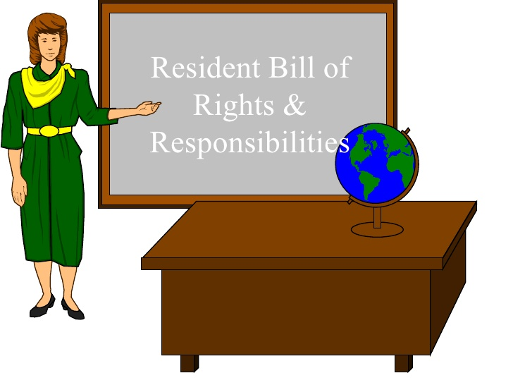
Watch the related webinar
Resident Rights
Notes:
When living in long term care, you or your loved one are likely to have concerns that pop up from time to time, and you should not be afraid to get them addressed. It is your right to do so. Residents have many rights - For further information on your other rights as a long-term care resident please watch the companion to this webinar called: [Residents' Rights by Lori Smetanka].

Slide 6

Choosing how to address a concern
Notes:
There are many ways to address a complaint in this system. How you choose to address your concern depends on the nature of it.
In general here is the format to follow:

Slide 7
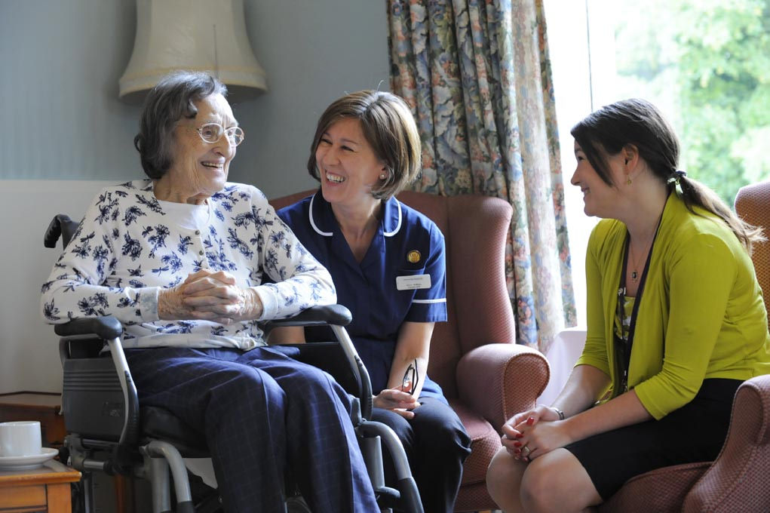
Start with facility staff
Notes:
Ideally, speak to the staff at the facility first. This is usually the quickest way to get to a resolution. The staff work day to day with the residents and are in a position to handle a problem or complaint the fastest.
When you attempt to do this keep these pointers in mind:
While your issue may seem obvious to you, the staff might not know it is occurring. Bringing it up helps them to provide better care to you or your loved one.
Make sure you speak to a staff member who is in a position to address your concern. This could be the unit manager, the social worker, the director of nurses, or the administrator. While it may be tempting to tell a CNA, as they may be the staff you see the most, they often are not in a position to make changes and they may forget to pass your concern on to someone who can - not because they don't want to help you, but because they were busy caring for you or your loved one and other residents on the unit and they might simply forget.
By law the facility is required to have a grievance policy and someone on staff to handle them – this person, in the law, is identified as a grievance official – But you shouldn’t be afraid to speak with any staff member that is in a position to help you as mentioned previously. In my experience key staff is willing to hear from you and will direct you to another person if needed.
A benefit to approaching the staff first is that it shows them you are invested in your or your loved one's care and you are giving them an opportunity to address your concern and hopefully come to a mutually agreeable resolution.
Once you have presented your concern ask them to give you an idea of how and when they will address it and if necessary ask them when they will get back to you. Depending on the complaint, It may take a few rounds of communication before a resolution is reached.

Slide 8


Notes:
If you don't feel like your issue was addressed, or if you feel like brainstorming your concern before approaching the facility, seek out your facility's ombudsman. Put simply, an ombudsman is an advocate.
The facility ombudsman is most often a volunteer, or sometimes paid ombudsman program staff, who has been trained and certified by the Massachusetts State Ombudsman Program to be a resident advocate. The Ombudsman Program is mandated by the Older Americans Act and exists nationally.
Ombudsmen do not work for the facility.
They make regular, unannounced visits to their assigned long-term care facility. They are available to all residents who wish to speak with them.
All conversations with the Ombudsman are confidential - they will not act on the resident's behalf, nor discuss any concerns with the facility without the resident's permission or permission from the resident's legal representative.
If you are not the resident nor their legal representative, you can still talk with them to get suggestions on how to handle a particular concern. They are a great resource for understanding residents rights.
Each facility will post how to reach the Ombudsman. The Ombudsman will most likely ask what you have already done to address your concern. If you have not done so already they will often suggest that you first speak with the facility staff.
In cases where the concern comes from the family, but not a resident's legal representative, the Ombudsman may seek out the resident and ask if this is an issue where the resident would like Ombudsman assistance. Or the Ombudsman will look to speak with the legal representative for the same permission - this could be a resident's invoked health care proxy or legal guardian. However, even if a guardian is in place, or a health care proxy is activated, the ombudsman may still seek the resident’s input. Even residents with diminished capacity have the right to have their views known and considered in the grievance process.
If you have already attempted to address your concern and it does not get resolved to your satisfaction, or is not getting addressed at all, then the Ombudsman can help you advocate to get your concerns addressed.

Slide 9

Resident & Family Council
Notes:
For concerns that are more general in nature and may also be effecting other residents, not just yourself or your loved, such as consistently cold food, poor call bell response times, or lack of staffing etc., consider attending a Resident or Family Council Meeting to get it addressed.
These groups are supported by Federal Law which states:
(5) The resident has a right to organize and participate in resident groups in the facility.
(i) The facility must provide a resident or family group, if one exists, with private space; and take reasonable steps, with the approval of the group, to make residents and family members aware of upcoming meetings in a timely manner.
(ii) Staff, visitors, or other guests may attend resident group or family group meetings only at the respective group's invitation.
(iii) The facility must provide a designated staff person who is approved by the resident or family group and the facility and who is responsible for providing assistance and responding to written requests that result from group meetings.
(iv) The facility must consider the views of a resident or family group and act promptly upon the grievances and recommendations of such groups concerning issues of resident care and life in the facility.
(A) The facility must be able to demonstrate their response and rationale for such response.
(B) This should not be construed to mean that the facility must implement as recommended every request of the resident or family group.
(6) The resident has a right to participate in family groups.
(7) The resident has a right to have family member(s) or other resident representative(s) meet in the facility with the families or resident representative(s) of other residents in the facility.
While facilities usually have a Resident Council, many do not have a Family Council. If your loved one's facility does not currently have a Family Council and you would like to start one you have a right to do so by law. Massachusetts Law expands on Federal Law for Family Council - here are some of the key details:
The Facility is required to provide space for attendees to meet monthly at agreed upon hours.
The council has the ability to seek assistance from an entity outside of the facility, and can receive unopened mail at the facility's address.
The facility is required to interact with the family council in the following ways:
Hear the council's concerns and suggestions. If any are presented to the facility in writing, the facility must respond back to them in writing within five working days.
Provide bulletin board space for the council to display council business - such as notices of upcoming meetings and past meeting minutes.
Provide staff assistance as requested.
Inform new residents and their families and/or designated representatives of the family council, including contact info, and meeting times if one exists, or the right to form a family council.
And the facility must not willfully interfere with the formation, maintenance, or promotion of a family council.
These meetings are a safe space for residents, permitted families, and representatives to speak up. Concerns are collected and presented to facility administration as a group concern - this way the staff will not know who is voicing the complaint. It allows individual participation that is confidential – this is important because while the law supports a residents right to voice their complaints without retaliation – often the fear of retaliation prevents people from speaking up. It naturally may be easier to speak up if you can do so anonymously.
Another option, while not considered a family council, could be some facilities might invite families to a meeting to get input on ways to improve life for residents. Such partnership approaches can also be very valuable.
Issues of a personal nature should be addressed directly with the facility and/or Ombudsman to ensure a resident's privacy.

Slide 10

Care Plan Meetings
Notes:
Another option is to present your concerns at a routine care plan meeting. But, depending on the nature of the concern, you might only want to consider this if you have one coming up. Don't feel you have to wait weeks or months to get a concern addressed.
By law a facility is required to meet quarterly and as needed to discuss a resident's plan of care. The resident and their representative has a right to attend these meetings - in fact it is encouraged. Staff representing different departments will usually attend. This includes nursing, social services, and activities to name a few.
You can also ask for a meeting similar to this outside of the normal quarterly schedule to have your concern addressed. These are often called family meetings even though the meeting is about the resident and residents can ask for a meeting too.
Care plan and family meetings can also serve as a way of establishing and maintaining lines of communication with staff of the facility that residents and families may not see on a regular basis.

Slide 11

Department of Public Health
Notes:
CMS, The Centers for Medicare and Medicaid Services, certifies nursing homes. In Massachusetts this done through The Department of Public Health also known as the DPH. To say it another way,
the Massachusetts Department of Public Health licenses nursing and rest homes in the state. They are the regulatory body. They perform an annual inspection of skilled nursing facilities and they investigate instances of abuse, neglect, mistreatment and misappropriation of long-term care residents.
The annual inspection, called a survey, takes place 9 - 15 months from the date of the last survey. A facility will know their window when the inspection could take place but they will not know when the inspection will start as they are unannounced.
You have the option to speak with the DPH staff, known as surveyors, during the annual survey. If your facility is in the middle of a survey a notice will be posted in the building - usually on the front door. Surveyors will be working throughout the building and are willing to speak with residents and families of residents regarding their concerns. They may ask you what you have done to address it yourself.
The DPH also investigates concerns of resident care and safety such as instances of abuse such as physical, emotional, & sexual abuse, neglect, mistreatment, such as mistreatment of medications – this could be giving a resident the wrong medication by accident or intentionally, and misappropriation – such as the misuse of resident funds or property. If you have concerns about you or your loved one’s care or safety consider filing a complaint with the DPH.
It is still a good idea to inform the facility first. For practical purposes the facility can address it quickly and in many cases is required to self-report to the DPH. Concerns this serious in nature should be dealt with immediately so the resident does not continue to be in harm. The facility will takes these complaints very seriously as they should. Facilities are required to ensure the safety and welfare of the residents they serve.

Slide 12

Recap
Staff
Ombudsman
Resident and/or Family Council
Care Plan Meetings
The Department of Public Health
Notes:
In summary, Don't be afraid to speak up! You have a right to have your concerns addressed.
Try the staff first and ask them when you will get a response.
Then or simultaneously, consider enlisting the help of the Ombudsman.
For more global concerns participate in the Resident Council or Family Council.
Consider care plan meetings depending on when they are scheduled to occur - or ask for a meeting to discuss your concern with the team.
Last but not least, and for serious concerns, contact the DPH.

Slide 13
Contact and Resources
Staff can be found at the long-term care facility.
Massachusetts Ombudsman Program 1-800-243-4636
The Department of Public Health call: 1-800-462-5540 or fax: (617) 753-8165
Resources
Notes:
Finally, Some tips on how to contact these individuals:
Staff, as you know, can be found at the long-term care facility. The key problem solvers can usually be found during regular business hours. However, there is always a supervisor on duty. The staff can also tell you where and when resident and family council meetings take place and how to get in touch with them. And they can tell you when the next routine care plan meeting is scheduled. Or schedule a separate meeting with you.
If you can't find the Ombudsman Program information in your facility you can call the toll free number listed to be directed to the correct program.
File complaints to the Department of Public Health by calling the toll free number listed. Another option is to file your complaint in writing which can be mailed or faxed. For further information about any of these topics check out the links provided on the website.
---------------------------------------------------------------------------------
Thank you so much Marci, for so clearly describing the strategies for problem solving in nursing homes. That was really excellent, and will be a valuable resource for our audience.
Thank you all for joining us – that concludes this educational session.

